Slide 1
Integrating PolicyCenter with BillingCenter
November 14, 2014
Notes:
Guidewire training materials contain Guidewire proprietary information that is subject to confidentiality and non-disclosure agreements. You agree to use the information in this manual solely for the purpose of training to implement Guidewire software solutions. You also agree not to disclose the information in this manual to third parties or copy this manual without prior written consent from Guidewire. Guidewire training may be given only by Guidewire employees or certified Guidewire partners under the appropriate agreement with Guidewire.

Slide 2
Describe the cross-application integration points between PolicyCenter and BillingCenter
Enable account and producer management
Enable policy transaction processing
Enable delinquency

Slide 3
Overview of PC/BC integration
Account and producer processing
Billing instructions
Billing status
Late payment cancellation

Slide 4



Cross-application integration points
Guidewire applications are designed to exchange information with other Guidewire applications
A cross-application integration point represents an exchange of information between two Guidewire applications
Notes:
Every Guidewire application is designed to exchange information with other Guidewire applications. Each point of exchange is known as a cross-application integration point.
The cross-application integration points are designed to require minimal work to enable and re as little configuration work as possible to meet the needs of any customer.
There are also cross-application integration points between:
ContactManager and BillingCenter
ContactManager and PolicyCenter
ContactManager and ClaimCenter
There are no cross-application integration points between BillingCenter and ClaimCenter.

Slide 5
Cross-application integration points
Consist of Guidewire integration mechanisms:
Plugins registry elements
Preupdate and event fired rules
Messaging destinations
Web service collections and APIs
Enablement consists of basic configurations:
Enable rules
Enable messaging destinations
Configure and enable plugins
Edit xml files
Refresh web service collections
GWP
Notes:
Cross-application integration points are built almost entirely from the standard Guidewire integration mechanisms. Some of the integration points use functionality that are not strictly integration mechanisms, such as xml files, assignment rules, and activity patterns.

Slide 6
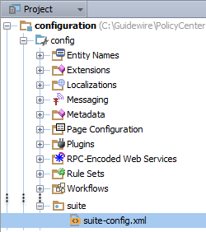
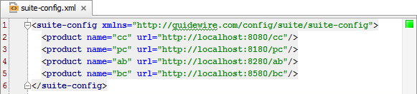
suite-config.xml
suite-config.xml specifies the Guidewire product URLs so that applications know where to connect to each other
Notes:
The suite-config.xml file exists in every Guidewire application. For a given instance of a Guidewire application, the file specifies the URLs required to connect to other Guidewire applications.
When enabling cross-application integration points, edit the file and specify the correct URLs for each application.

Slide 7


Cross-application integration points:
PolicyCenter and BillingCenter
Producer Organization
Account and producer processing
Producer
Account Management
Account
New Business Processing
Billing Plan
Endorsement Processing
Billing instructions
Payment Plan
Commission Plan
Renewal Processing
Invoicing
Cancellation Processing
Late payment cancellation
Delinquency Plan
Billing View
Billing status
Billing Status
Notes:
In the slide example, the diagram shows a high-level view of PolicyCenter and BillingCenter integration.
Account and producer processing consists of PolicyCenter sending newly created producers, producer codes, and accounts to BillingCenter.
Billing instructions consists of PolicyCenter sending a billing instruction to BillingCenter whenever a policy transaction is issued.
Late payment cancellation consists of BillingCenter initiating the cancellation process in
PolicyCenter when a given account reaches the end of a delinquency process.
Billing status consists of PolicyCenter users viewing data about policy billing in BillingCenter.

Slide 8
Overview of PC/BC integration
Account and producer processing
Billing instructions
Billing status
Late payment cancellation

Slide 9
System of record (SOR) appplication
A system of record (SOR) is the authoritative data source for a given piece of information
PolicyCenter and BillingCenter share account, policy period, billing, and other information
Most shared information originates in PolicyCenter and is pushed to BillingCenter
Often, BillingCenter is SOR for billing-related data and PolicyCenter is SOR for everything else
PolicyCenter and BillingCenter exchange information through web service calls
Through integration, a third party can be SOR for information such as producers and producer codes
Notes:
Both BillingCenter and the policy administration system maintain shared account, policy period, billing, and other information. While both applications have access to the information, only one application, either PolicyCenter or BillingCenter, is the system of record (SOR) for each piece of information. Most information originates in PolicyCenter and the relevant information is "pushed" to BillingCenter. Updates made to accounts, policies, and producers in BillingCenter typically are not updated in PolicyCenter.
You can customize some aspects of the integration to use a third party application as the system of record. That system may provide shared information to both BillingCenter and the policy system. For example, a carrier can have a producer management system that manages producers and producer codes for both systems.
PolicyCenter retrieves billing information from BillingCenter and displays this billing information in account and policy files to provide PolicyCenter users with various aspects of billing status. A PolicyCenter user with a BillingCenter login can use links to view billing information within BillingCenter.

Slide 10
PolicyCenter manages producers (1)
Producer code
Associates policies to the organization
Manages permissions and data-level security
Agents are organization users that have access to producer codes
Producer code
Associates commission plans to producer
Agents do not have direct access to BillingCenter
Notes:
In PolicyCenter, an organization can have multiple producer codes. An organization in PolicyCenter corresponds to a producer in BillingCenter. In BillingCenter, a producer can have multiple producer codes.
PolicyCenter manages and sends updates to BillingCenter.
External Producer Management
If a carrier has an external producer management system, the external system manages the producer and producer code and sends details to both PolicyCenter and BillingCenter. Additional configuration is necessary to implement this approach. For example, you need to:
Disable the ability to edit producers and producer codes in the PolicyCenter and BillingCenter applications
Turn off add/update messaging for producers from PolicyCenter to BillingCenter
Provide integration to update tables in PolicyCenter and BillingCenter databases
Differences in Producer Models Between PolicyCenter and BillingCenter
BillingCenter customers may have a requirement to integrate to policy administration systems other than PolicyCenter. For this reason, the producer model in BillingCenter differs in some respects from that in PolicyCenter: BillingCenter allows a user to transfer multiple policies between a source and destination producer, whereas this feature is not supported in PolicyCenter; and PolicyCenter users can select a primary producer only, whereas BillingCenter allows selection of primary, secondary, and referrer producers.

Slide 11
PolicyCenter manages producers (2)
Add new producer
Add new producer code
Change producer name, tier, contact details
Change producer code status
PolicyCenter provides default values for a small set of fields related to commission plans and agency bill plans in order to create producers and producer codes
BillingCenter is the SOR for anything related to
Agency bill plans and commission plans
Assignment of plans to a producer or producer code
Notes:
Users create producer organizations and producer codes in PolicyCenter, which are then pushed into BillingCenter. Public IDs provide the means for matching a PolicyCenter Organization entity with the corresponding BillingCenter Producer entity. At the time the PolicyCenter producer organization is created, PolicyCenter obtains valid agency bill plan choices from BillingCenter. When producer codes are created in PolicyCenter, PolicyCenter obtains valid commission plans from BillingCenter. After PolicyCenter sends a producer to BillingCenter, these plan assignments become the responsibility of BillingCenter. PolicyCenter also sends contact information for producer contacts and sends updates whenever contact details are subsequently changed in PolicyCenter. BillingCenter does not send updates back to PolicyCenter if producer details are changed within BillingCenter.
Transferring Policies Between Producers
The Transfer Producer Wizard in BillingCenter enables you to transfer multiple policies from one producer to another in a single operation. In the default configuration, BillingCenter does not inform PolicyCenter when policies have been transferred to another producer. Typically, a billing representative would inform underwriting to switch the producer of service in PolicyCenter as soon as BillingCenter completes the transfer operation.

Slide 12
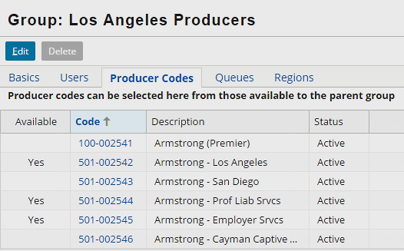
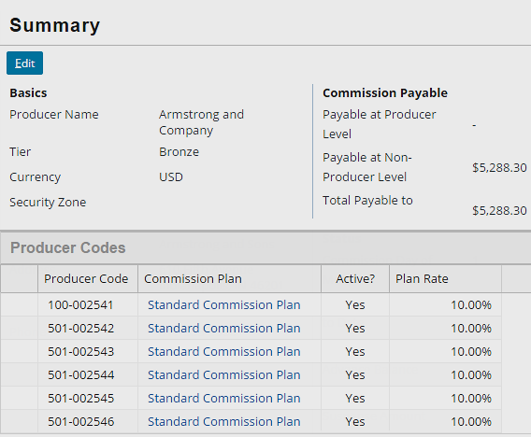
Producers in PolicyCenter and BillingCenter
An organization in PolicyCenter corresponds to a producer in BillingCenter
Notes:
An organization in PolicyCenter corresponds to a producer in BillingCenter. You can group organizations in PolicyCenter. Organizations are grouped in the Actions sidebar as a hiearchy tree. The hierarchial groupings of producers are not replicated in BillingCenter.

Slide 13
PolicyCenter manages accounts
Add new account at time of binding first policy
Change account holder
Add a billing contact
Change billing contact info
Merge accounts
Transfer policy to another account
PolicyCenter provides default values for a small set of account fields that BillingCenter maintains in order to create new accounts
BillingCenter is the SOR for billing plan and account-level settings that control invoicing
Notes:
PolicyCenter sends information about new accounts to BillingCenter only when the account has a bound submission. In many cases, accounts known to PolicyCenter never complete any submission. Therefore, there are typically PolicyCenter accounts that are never made known to BillingCenter.
To avoid duplicating existing billing accounts, PolicyCenter always searches BillingCenter to determine whether the account exists prior to sending a new account.
When BillingCenter receives a billing instruction, it becomes the system of record for the billing-related information for an account. Subsequently, BillingCenter matches account updates from PolicyCenter by means of the account number. In the default configuration, a one-to-one relationship is assumed between PolicyCenter and BillingCenter accounts. BillingCenter also can support the creation of subaccounts. In this case, BillingCenter creates new billing accounts that are not stored in PolicyCenter. When you update an account in BillingCenter, BillingCenter does not send the updates to PolicyCenter.

Slide 14
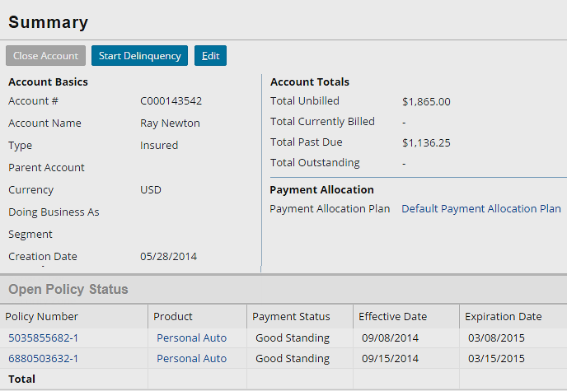
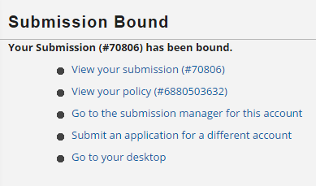
PC job binding sends new accounts to BC
Mechanism that sends billing instructions manages new account and producer data
Notes:
When a job with billing implications is bound, a billing instruction is sent to BillingCenter. If it references an account that is unknown to BillingCenter, then the account is also created in BillingCenter at this time.

Slide 15
Overview of PC/BC integration
Account and producer processing
Billing instructions
Billing status
Late payment cancellation

Slide 16
Billing instructions
1
User quotes
2
Perform plan lookup
3
User selects plan
4
User requests payment schedule preview
5
Calculate payment schedule
6
User issues policy
7
Create account
8
Create policy / policy period
Notes:
A new policy is created in BillingCenter on submission. In some cases, a new policy can be created on renewal. A new policy period is created for submission, renewal, and rewrite. Any mid-term changes to payment plans or billing method for a policy must be done in BillingCenter directly.
The message sent to BillingCenter includes billing instructions regarding charges and any changes to the policy period. PolicyCenter informs BillingCenter about a new policy, new policy period, cancellation, reinstatement, and so on.
A new policy is created in BillingCenter on submission (that is, when a policy is bound or issued). In some cases, a new policy can be created on renewal. A new policy period is created for submission, renewal, and rewrite. Any mid-term changes to payment plans or billing method for a policy must be done in BillingCenter directly.

Slide 17
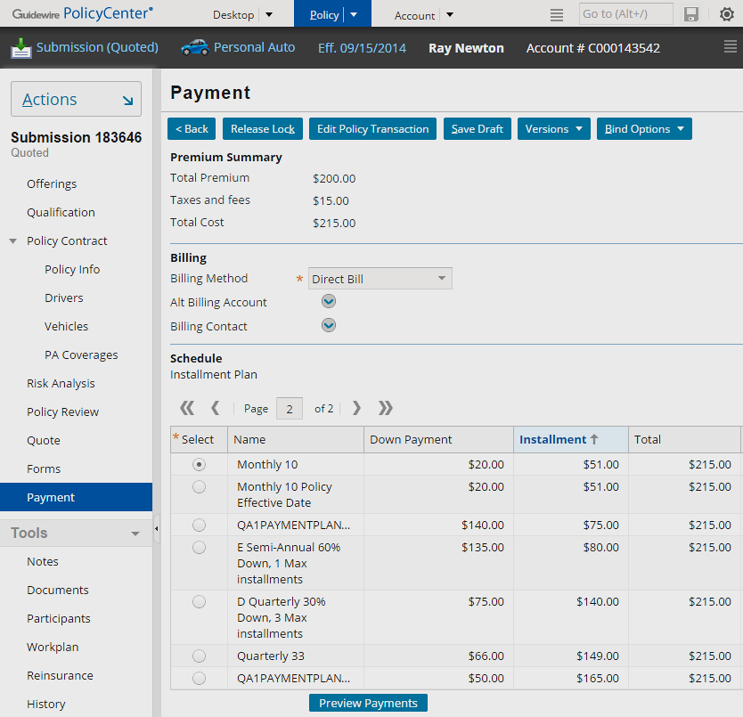
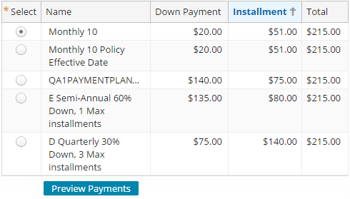
Installment plans queried with every quote
PolicyCenter queries for payments plans from BillingCenter for each job quote
"Installment plan" refers to BillingCenter payment plan
Notes:
Prior to binding a transaction with payment implications, PolicyCenter displays a list of installment plans. Note that the term "installment plans" in PC refers to BillingCenter payment plans with the IsReporting property set to No. PolicyCenter queries the plans every time a transaction is quoted because the down payment, installment, and total need to be calculated with every quote, and this calculation occurs in BillingCenter.
The sample data payment plans in BillingCenter were not designed with all lines of business in mind. For example, personal auto policies typically have a 6-month term, but all the payment plans are designed to accommodate annual-term policies.

Slide 18
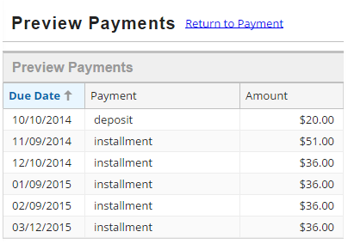
Previewing payment details in PolicyCenter
BillingCenter provides the preview payments details for PolicyCenter
Notes:
Once you have selected a payment plan, the Preview Payments button appears. This provides details about each payment that would occur if the associated plan is selected. The dates, payment types, and amounts come from BillingCenter.

Slide 19
Billing process
1
User quote
Billing instructions with transaction amounts and/or changes to policy period
2
User binds policy transaction
3
Allocate charges to payment schedule
4
Calculate commissions
Policy transactions include submission, policy change, cancellation, reinstatement, renewal, rewrite, final audit, and premium report
5
Make any policy period changes
Notes:
The message sent to BillingCenter includes billing instructions regarding charges and any changes to the policy period. PolicyCenter informs BillingCenter about a new policy, new policy period, cancellation, and reinstatement. Note that PolicyCenter does not send an actual billing instruction. Instead, it sends a message from which BillingCenter generates the billing instruction.

Slide 20
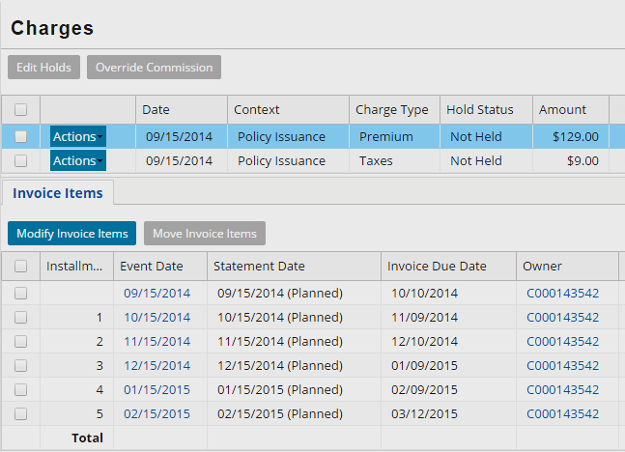
Sending billing instructions
Billing instruction
When a transaction with billing implications is bound, PolicyCenter sends a message to BillingCenter that results in a billing instruction
Notes:
When a job with billing implications is bound, a billing instruction is sent to BillingCenter. If it references an account that is unknown to BillingCenter, then the account is also created in BillingCenter at this time.
When a transaction with billing implications is bound, PolicyCenter sends a message that results in a billing instruction to BillingCenter. The message sent to BillingCenter includes billing instructions regarding charges and any changes to the policy period. PolicyCenter informs BillingCenter about a new policy, new policy period, cancellation, or reinstatement.

Slide 21
How do account, producer, and billing
instruction processing work?
Policy transaction issued
GWP
IBilling System Plugin
BCBilling System Plugin
BCBilling System API
Billing API
Notes:
Once enabled, account, producer, and billing instruction processing work in the following way:
Once a policy transaction is issued, the IBillingSystem plugin is triggered. The plugin registry entry points to the gw.plugin.billing.bc800.BCBillingSystemPlugin class.
The BCBillingSystemPlugin class makes use of a web service, BCBillingSystemAPI, that references the BillingCenter web service, BillingAPI. This API contains the methods needed to verify the existence of or create producers and accounts, as well as to submit billing instructions to BillingCenter.

Slide 22
Steps to enable account, producer, and
billing instruction processing
BillingCenter
PolicyCenter
Start BillingCenter
Open IBillingSystemPlugin
Change the Gosu class
Edit the plugin configuration
Edit suite-config.xml
Refresh the Web Service collection WSDL
Deploy your changes
Notes:
The steps identify the 800 version of the plugin class and pertains to a PolicyCenter 8.0.2 integration with BillingCenter. If you are integrating BillingCenter with a version of PolicyCenter later than 8.0.2, consult the BillingCenter Installation Guide for specific integration related configurations.

Slide 23
Start BillingCenter
Step 1
gwbc dev-start
Starts BillingCenter
BillingAPI web service starts
C:\Guidewire\BillingCenter\bin>gwbc dev-start
dev-start: ==================================================== = Running main class: com.guidewire.commons.jetty.GWServerJettyServerMain
…
[JAVA] machine 2014-10-10 INFO ***** BillingCenter ready *****

Slide 24
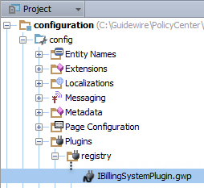
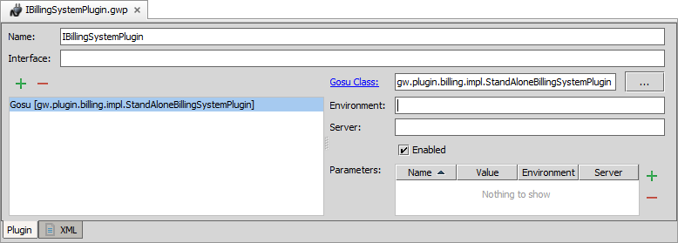
Open IBillingSystemPlugin
Step 2
In Guidewire Studio for PolicyCenter, open IBillingSystemPlugin.gwp

Slide 25
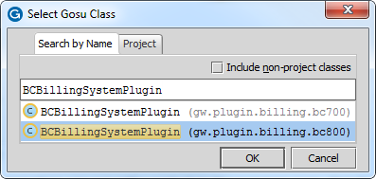
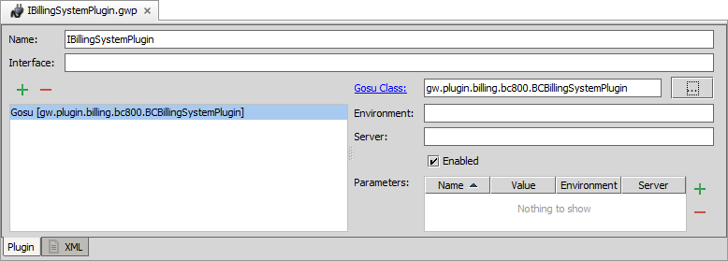
Change the Gosu class
Step 3
In Plugin Editor, change the Gosu class
Click ellipse (…)
Search for BCBillingSystemPlugin (bc800)
2
1
Notes:
The instructions above identify the "800" version of the plugin class. This works when integrating PolicyCenter with BillingCenter 8.0.2, but it may or may not work with later versions of BillingCenter.
If you are integrating PolicyCenter with a version of BillingCenter later than 8.0.2, you should consult the PolicyCenter Installation Guide to determine if there are later versions of these resource that would be better to use.
gw.plugin.billing.bc800.BCBillingSystemPlugin is the fully qualified class name.

Slide 26
Edit the plugin configuration
Step 4
Enable, if disabled
1
Notes:
Developers should be aware of the fact that when you load sample data into PolicyCenter, the producers and accounts are copied over to BillingCenter. If you are working with integrated instances of PolicyCenter and BillingCenter and wish to have the sample data between the two applications synchronized, then you should load sample data in this order:
Start BillingCenter, and load the BillingCenter sample data.
If you have already loaded the PolicyCenter sample data, drop the PolicyCenter database.
Enable to account, producer, and policy transaction processing integration point per the instructions in the slide above.
Start PolicyCenter and load the PolicyCenter sample data. (Because the integration is enabled when the sample data load occurs, the producers and accounts are copied over to BillingCenter.)

Slide 27
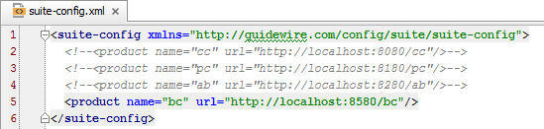
Edit suite-config.xml
Step 5
Specify the URL for BillingCenter in suite-config.xml
Notes:
In a development environment, the web service URL does not need to be modified if both applications are on the same machine and BillingCenter is using the default port (8580).
In a production environment, the web service URL may need to be modified if both applications are not on the same machine or if BillingCenter is not using the default port (8580).

Slide 28
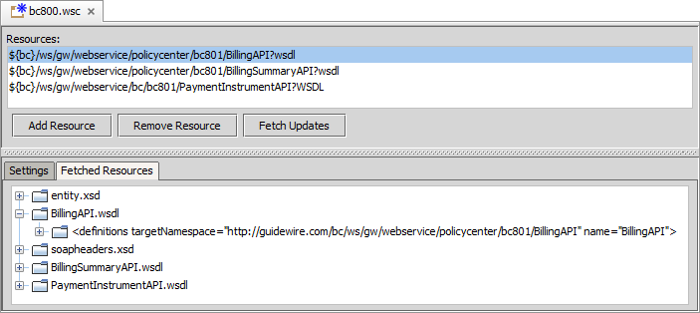
Refresh web service collection WSDL
Step 6
Open the bc800.wsc collection in Studio
…\gsrc\wsi\remote\gw\webservice\bc\bc800.wsc
To refresh the web service collection WSDL, click Fetch Updates
Notes:
The BillingCenter server must be running in order to fetch the WSDL.

Slide 29
Deploy your changes
Step 7
Restart Server
Reload Changed Classes
Plugin registry elements
Always required for cross-point integration
Class and mapping files
GWP
Plugin Registry
Gosu Class
Notes:
You must restart the server when you create or modify destinations, plugin registry elements, and/or reply plugins.

Slide 30
Overview of PC/BC integration
Account and producer processing
Billing instructions
Billing status
Late payment cancellation

Slide 31
PolicyCenter has internal and external users
External user
Internal user
Independent agent that does not work for carrier
Has access to PolicyCenter, but not BillingCenter
Gets basic information from PolicyCenter
Works for carrier
Probably has access to BillingCenter
Gets basic information from PolicyCenter
When necessary, uses BillingCenter to view billing details
Producer
Underwriter
Notes:
The producer is an independent agent and therefore an external user.
If the carrier is a direct writer, the producer could be an employee and therefore an internal user.

Slide 32
Viewing billing info in/from PolicyCenter
in PolicyCenter
in BillingCenter
Is the policy current?
When is next invoice due?
How much has been paid on current invoice?
What item is past due?
What is the delinquency history for this account?
Producer
Underwriter
Underwriter
Producer

Slide 33
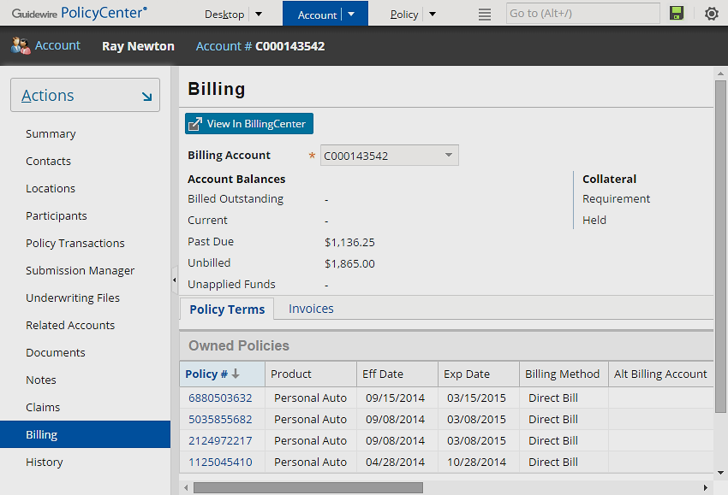
Viewing billing information for an account
in PolicyCenter
View account-level billing information on Account → Billing
For internal and external users with BillingCenter access
Notes:
For any account (including sample data account), internal and external users can view account-level billing information on the account's Billing screen in PolicyCenter.

Slide 34
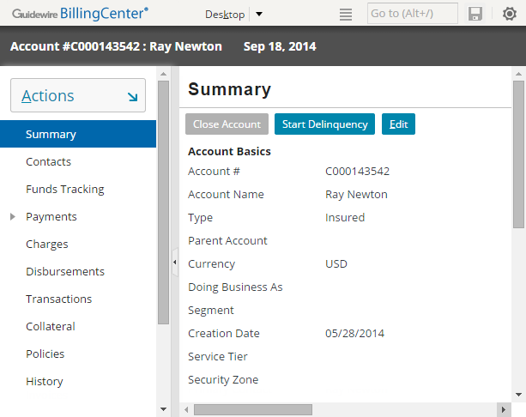
Viewing billing information for an account
through an exit point to BillingCenter
"View In BillingCenter" is exit point
Button appears for users that have view billing system permissions
Allows direct access to detailed billing information in BillingCenter
Notes:
For any account (including a sample data account), an underwriter with a user account in BillingCenter can view more detailed billing information through an exit point to BillingCenter.
The "View in BillingCenter" button is visible when there is both a value for the BillingSystemURL attribute in the config.xml file and if the user viewing the Account Billing page belongs to a PolicyCenter role that has the view billing system permissions.

Slide 35
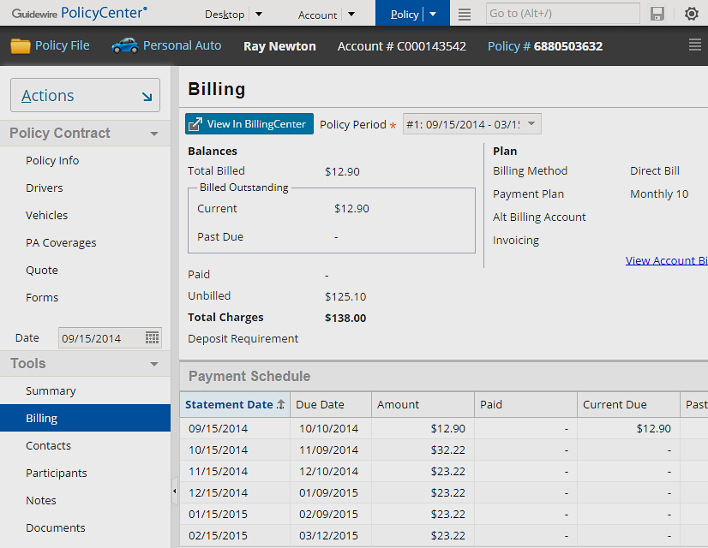
Viewing billing information for a policy
in PolicyCenter
View account-level billing information on Policy → Billing
For internal and external users with BillingCenter access
Notes:
For any policy (including sample data policies), internal and external users can view some billing information on the policy's Billing screen in PolicyCenter.

Slide 36
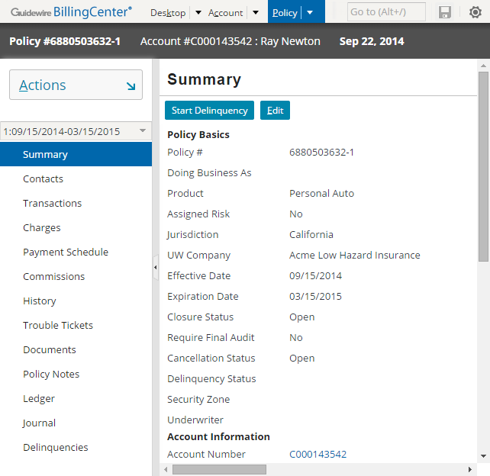
Viewing billing information for a policy
through an exit point to BillingCenter
"View In BillingCenter" is exit point
Button appears for users that have view billing system permissions
Allows direct access to detailied billing information in BillingCenter
Notes:
For any policy (including sample data policies), an underwriter with a user account in BillingCenter can view more detailed billing information through an exit point to BillingCenter.
The "View in BillingCenter" button is visible when there is both a value for the BillingSystemURL attribute in the config.xml file and if the user viewing the Account Billing page belongs to a PolicyCenter role that has the view billing system permissions.

Slide 37


How does viewing billing data work?
User requests to view billing information
GWP
IBilling Summary Plugin
BCBilling Summary Plugin
BCBilling SummaryAPI
Billing Summary API
BCPolicy (exit point)
Policy PeriodEntry (entry point)
Notes:
Once it is enabled, billing status works in the following way:
Whenever a PolicyCenter user requests to view billing information in PolicyCenter, the request triggers the IBillingSummary plugin. The plugin registry entry for this plugin points to the gw.plugin.billing.bc800.BCBillingSummaryPlugin class.
The BCBillingSummaryPlugin class makes use of a web service endpoint, BCBillingSummaryAPI, that references the BillingCenter web service, BillingSummaryAPI. This API contains the methods needed to retrieve information from BillingCenter about the billing status of the policy or account.
When a PolicyCenter user clicks the "View in BillingCenter" button, this button navigates to the PolicyCenter BCPolicy exit point which in turn navigates to the PolicyPeriodEntry entry point in BillingCenter.
Exit point configuration parameters are configured in config.xml and not in suite-config.xml.
The configuration parameters in suite-config.xml support integration between Guidewire applications through web services. The exit point configuration parameters in config.xml support integration between web browsers.

Slide 38
Steps to enable viewing billing data
BillingCenter
PolicyCenter
Start BillingCenter
Open IBillingSummaryPlugin
Change the Gosu class
Edit the plugin configuration
Edit configuration xml files
Refresh the Web Service collection WSDL
Deploy your changes
Notes:
The steps identify the 800 version of the plugin class and pertains to a PolicyCenter 8.0.2 integration with BillingCenter. If you are integrating BillingCenter with a version of PolicyCenter later than 8.0.2, consult the BillingCenter Installation Guide for specific integration related configurations.

Slide 39
Start BillingCenter
Step 1
gwbc dev-start
Starts BillingCenter
BillingSummaryAPI web service starts
C:\Guidewire\BillingCenter\bin>gwbc dev-start
dev-start: ==================================================== = Running main class: com.guidewire.commons.jetty.GWServerJettyServerMain
…
[JAVA] machine 2014-10-10 INFO ***** BillingCenter ready *****

Slide 40
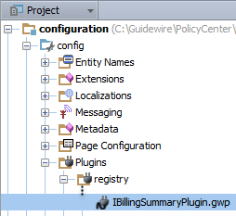
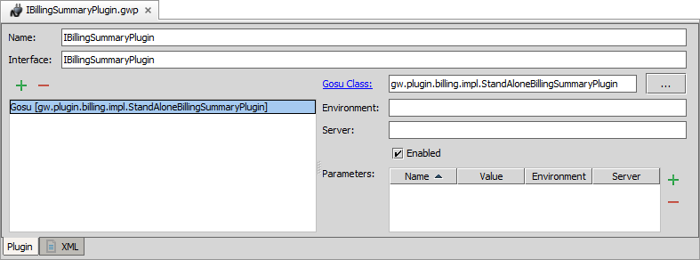
Open IBillingSummaryPlugin
Step 2
In Guidewire Studio for PolicyCenter, open IBillingSummaryPlugin.gwp

Slide 41
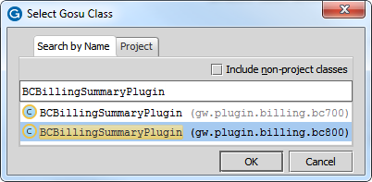
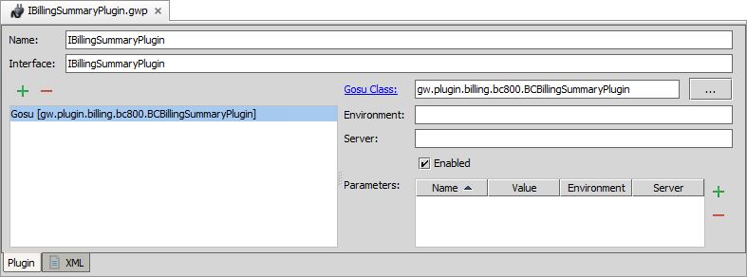
Change the Gosu class
Step 3
In Plugin Editor, change the Gosu class
Click ellipse (…)
Search for BCBillingSummaryPlugin (bc800)
2
1
Notes:
The instructions above identify the "800" version of the plugin class. This works when integrating PolicyCenter with BillingCenter 8.0.2, but it may or may not work with later versions of BillingCenter.
If you are integrating PolicyCenter with a version of BillingCenter later than 8.0.2, you should consult the PolicyCenter Installation Guide to determine if there are later versions of these resource that would be better to use.

Slide 42
Edit the plugin configuration
Step 4
Enable, if disabled
1
Notes:
gw.plugin.billing.bc800.BCBillingSummaryPlugin is the fully qualified class name.
Developers should be aware of the fact that when you load sample data into PolicyCenter, the producers and accounts are copied over to BillingCenter. If you are working with integrated instances of PolicyCenter and BillingCenter and wish to have the sample data between the two applications synchronized, then you should load sample data in this order:
Start BillingCenter, and load the BillingCenter sample data.
If you have already loaded the PolicyCenter sample data, drop the PolicyCenter database.
Enable to account, producer, and policy transaction processing integration point per the instructions in the slide above.
Start PolicyCenter and load the PolicyCenter sample data. (Because the integration is enabled when the sample data load occurs, the producers and accounts are copied over to BillingCenter.)

Slide 43

Edit configuration xml files
Step 5
Specify the URL for BillingCenter in suite-config.xml
Add the exit point URL for BillingCenter in config.xml
Notes:
In a development environment, the web service URL does not need to be modified if both applications are on the same machine and BillingCenter is using the default port (8580).
In a production environment, the web service URL may need to be modified if both applications are not on the same machine or if BillingCenter is not using the default port (8580).

Slide 44
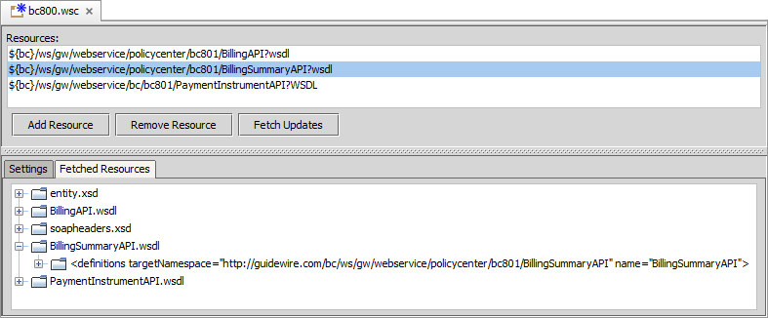
Refresh web service collection WSDL
Step 6
Open the bc800.wsc collection in Studio
…\gsrc\wsi\remote\gw\webservice\bc\bc800.wsc
To refresh the web service collection WSDL, click Fetch Updates
Notes:
The BillingCenter server must be running in order to fetch the WSDL.
If you already updated the WSDL for the bc800.wsc collection, then you do not need to update the WSDL again.

Slide 45
Deploy your changes
Step 7
Restart Server
Reload Changed Classes
Plugin registry elements
Always required for cross-point integration
Class and mapping files
GWP
Plugin Registry
Gosu Class
Notes:
You must restart the server when you create or modify destinations, plugin registry elements, and/or reply plugins.

Slide 46
Overview of PC/BC integration
Account and producer processing
Billing instructions
Billing status
Late payment cancellation

Slide 47
Cancellations
Initiated by the carrier or the insured
Starts in either PolicyCenter or BillingCenter
 | Carrier initiates cancellation when policy holder… | Insured initiates cancellation when…
PolicyCenter starts cancellation | Fails to provide necessary information, or Does not cooperate during final audit, or Does not provide premium report | Changing carrier Going out of business Moving out of insured geographical area
BillingCenter starts cancellation | Is past due on payments
Notes:
Cancellations can be initiated by the carrier or the insured. Cancellation processing starts in either PolicyCenter or BillingCenter. In the slide example, there are a few reasons for why a policy can be cancelled. Regardless of the nature of the cancellation, the Cancellation job is handled by PolicyCenter.

Slide 48
Late payment rescind
1
Delinquency plan executes cancellation
3
Start non-pay cancellation (status is pending)
Cancellation request
2
Payment received so rescind cancellation
4
Rescind pending cancellation
Rescind request
Notes:
The process for a late payment cancellation.

Slide 49
Late payment reinstatement
1
Delinquency plan executes cancellation
2
Start non-pay cancellation (status is pending)
Cancellation request
3
System issues cancellation on cancellation effective date
4
Process cancellation charges (usually credits)
Cancellation billing request
Billing rep informs underwriting of payment
5
Payment received
6
User decides to reinstate*
Reinstatement
billing
instruction
7
Process reinstate- ment charges
Notes:
In the BillingCenter base application, the delinquency workflow does not contain the logic to determine ow to reinstate a policy after the cancellation date.
In the slide examples, after Step 5, the billing representative (not BillingCenter) informs PolicyCenter of the late payment.
A carrier is obligated to rescind a cancellation when payment is received prior to the cancellation effective date. However, the carrier is not obligated to reinstate the policy after the cancellation effective date has been reached (and is “in effect”). This is why someone in PolicyCenter needs to make a decision whether to reinstate (this is, in general, a judgment call).

Slide 50
How does late payment cancellation work?
Deliquency workflow
Cancellation API
GWP
PolicyRenewal API
pc800
Policy System Plugin
IPolicy System Plugin
Notes:
Once enabled, late payment cancellation works in the following way:
In BillingCenter, when a delinquency workflow reaches a cancellation step, it triggers the IPolicySystemPlugin. The plugin registry entry for this plugin points to the gw.plugin.pas.pc800.PCPolicySystemPlugin class.
The PCPolicySystemPlugin class makes use of two web services in the web service collection wsi.remote.gw.webservice.pc.pc800. The web service collection references both the PolicyCenter CancellationAPI web service (PolicyCenter's wsi.remote.gw.webservice.pc.pc800.cancellationapi.CancellationAPI) and PolicyRenewalAPI web service (PolicyCenter's wsi.remote.gw.webservice.pc.pc800.policyrenewalapi.PolicyRenewalAPI). These APIs contain the methods needed to determine if a policy is currently under renewal, and to cancel or reinstate the policy as appropriate.
In the slide example, the diagram describes integration between PolicyCenter 8.0.2 and BillingCenter 8.0.2. Later versions of either product may come with updated versions of resources that are more appropriate to use. For example, when integrating with a version of BillingCenter later than 8.0.2, there may be a more up-to-date web service endpoint to use. If you are integrating products later than 8.0.2, consult the installation guides for each product to determine the best resources to use.

Slide 51
Steps to enable late payment
PolicyCenter
BillingCenter
Modify PolicyRenewalPlugin.gs
Start PolicyCenter
Open IPolicySystemPlugin.gwp
Change the Gosu class
Edit the plugin configuration
Edit suite-config.xml
Refresh the Web Service collection WSDL
Deploy your changes
Notes:
In the slide example, the steps identify the 800 version of the plugin class and pertains to a PolicyCenter 8.0.2 integration with BillingCenter. If you are integrating BillingCenter with a version of PolicyCenter later than 8.0.2, consult the BillingCenter Installation Guide for specific integration related configurations.

Slide 52
Enabling late payment cancellation
Step 1
1 package gw.plugin.job.impl
…15 class PolicyRenewalPlugin implements IPolicyRenewalPlugin { …147 override function isRenewalOffered( periodToRenew : PolicyPeriod ) : boolean { 148 return true 149 }
150
151 override function doesRenewalRequireConfirmation( periodToRenew : PolicyPeriod) : boolean { 152 return true
153 }
…155 } 156
In PolicyCenter PolicyRenewalPlugin's class, modify
iRenewalOffered() method to return true
doesRenewalRequireconfirmation() method to return true
Example: Line 148 and 152
Notes:
For modified Gosu plugin classes, you can Make Project or Reload Changed classes. You must restart the server when you create a new Gosu plugin class. You can restart the server from Studio by stopping a running server (debug mode is ok) and after the server stops, then running the server again in either Run or Debug mode.

Slide 53
Start PolicyCenter
Step 2
gwpc dev-start
Starts PolicyCenter
CancellationAPI web service starts
PolicyRenewalAPI web service starts
C:\Guidewire\PolicyCenter\bin>gwpc dev-start
dev-start: ==================================================== = Running main class: com.guidewire.commons.jetty.GWServerJettyServerMain
…
[JAVA] machine 2014-10-10 INFO ***** PolicyCenter ready *****
Notes:
The PolicyRenewalAPI manages renewals on policies in PolicyCenter. The CancellationAPI manages cancellations on policies in PolicyCenter.

Slide 54
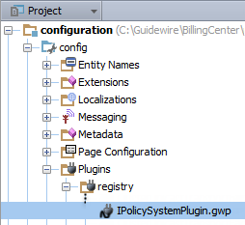
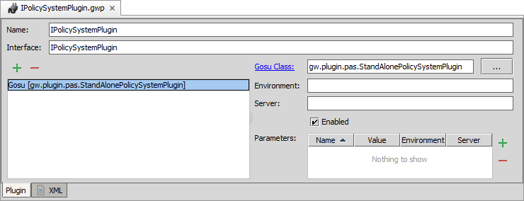
Open IPolicySystemPlugin
Step 3
In Guidewire Studio for BillingCenter, open IPolicySystemPlugin.gwp

Slide 55
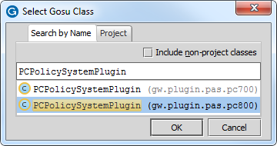
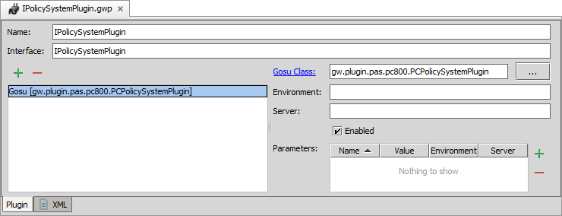
Change the Gosu class
Step 4
In Plugin Editor, change the Gosu class
Click ellipse (…)
Search for PCPolicySystemPlugin (pc800)
2
1
Notes:
gw.plugin.pas.pc800.PCPolicySystemPlugin is the fully qualified class name.

Slide 56
Edit the plugin configuration
Step 4
Enable, if disabled
1
Notes:
Guidewire only reads the contents plugin registry directory at server startup. You must restart the server when you create or modify plugin registry files.
You must restart the server when you create a new Gosu plugin class. For modified Gosu plugin classes, you can Make Project or Reload Changed classes.
You can restart the server from Studio by stopping a running server (debug mode is ok) and after the server stops, then running the server again in either Run or Debug mode.

Slide 57
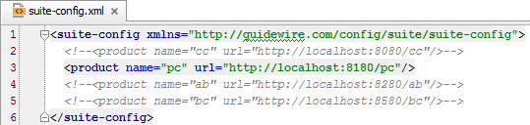
Edit suite-config.xml
Step 5
Specify the URL for PolicyCenter in suite-config.xml
Notes:
In a development environment, the web service URL does not need to be modified if both applications are on the same machine and PolicyCenter is using the default port (8180).
In a production environment, the web service URL may need to be modified if both applications are not on the same machine or if PolicyCenter is not using the default port (8180).

Slide 58
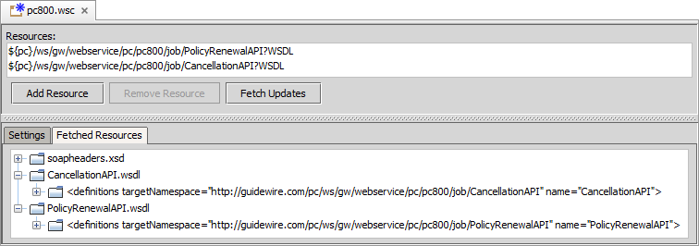
Refresh web service collection WSDL
Step 6
Open the pc800.wsc collection in Studio
…\gsrc\wsi\remote\gw\webservice\pc\pc800.wsc
To refresh the web service collection WSDL, click Fetch Updates
Notes:
The PolicyCenter server must be running in order to fetch the WSDL.

Slide 59
Deploy your changes
Step 7
Restart Server
Plugin registry elements
Always required for cross-point integration
GWP
Plugin Registry
Notes:
You must restart the server when you create or modify destinations, plugin registry elements, and/or reply plugins.

Slide 60
Describe the cross-application integration points between PolicyCenter and BillingCenter
Enable account and producer management
Enable policy transaction processing
Enable delinquency

